Slide 1
Photos (skin, eye)

Slide 2
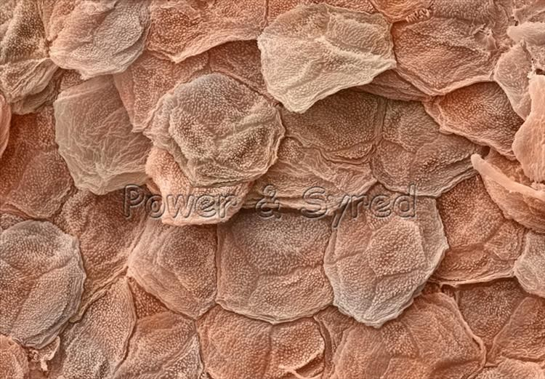

Slide 3
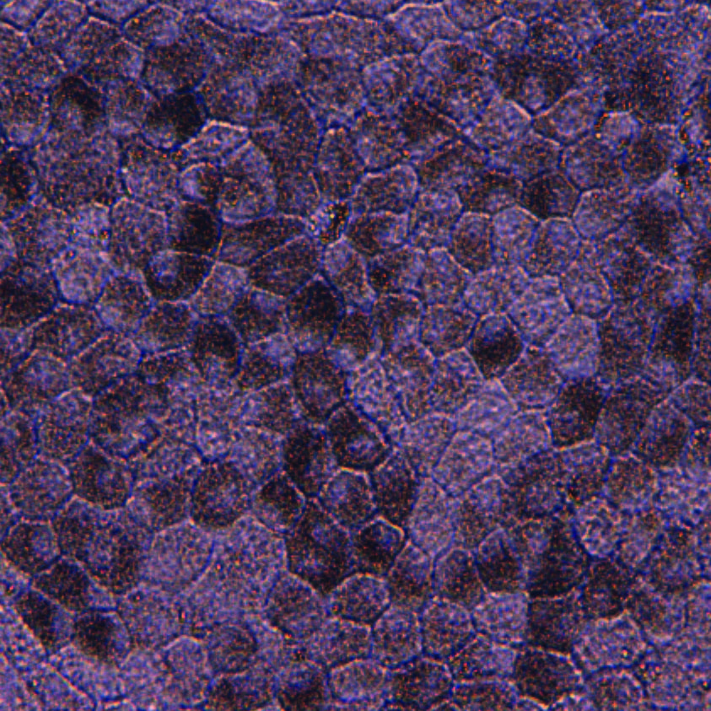

Slide 4
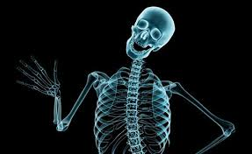
X-Ray

Slide 5
